Slide 1
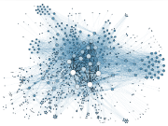
Self-Supervised Link Prediction vs. Supervised Classification in Graph Neural Networks for Anti-Money Laundering
Sandro Khizanishvili
Signal Processing for Machine Learning
Sapienza University of Rome
Feb 2026

Slide 2
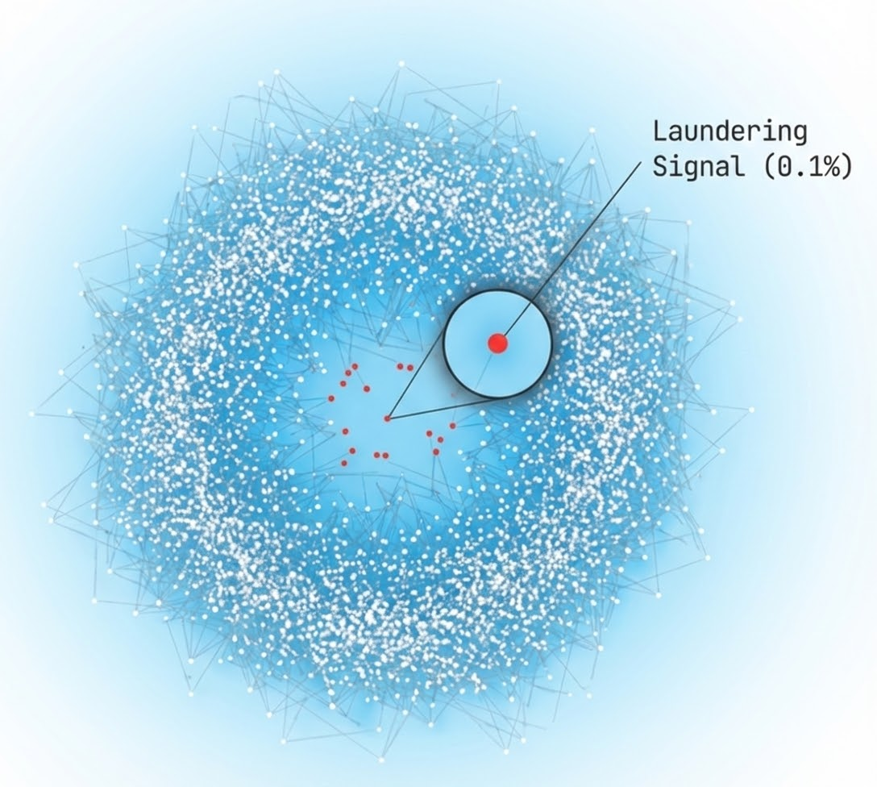
Introduction
Economic Impact: Global money laundering accounts for 2–5% of GDP (€1.7 T – €4T), yet detection remains inefficient.
False Alarms: Current rule-based systems suffer from >95% False Positive Rates, burying real threats in noise.
Label Scarcity: Real-world AML labels are rare, delayed, and expensive, making standard supervised learning impractical.
The Opportunity: Financial data is inherently relational. Graphs allow us to move beyond transaction "snapshots" to full structural context.
SPML - Self-Supervised Link Prediction vs. Supervised Classification in Graph Neural Networks for Anti-Money Laundering

Slide 3
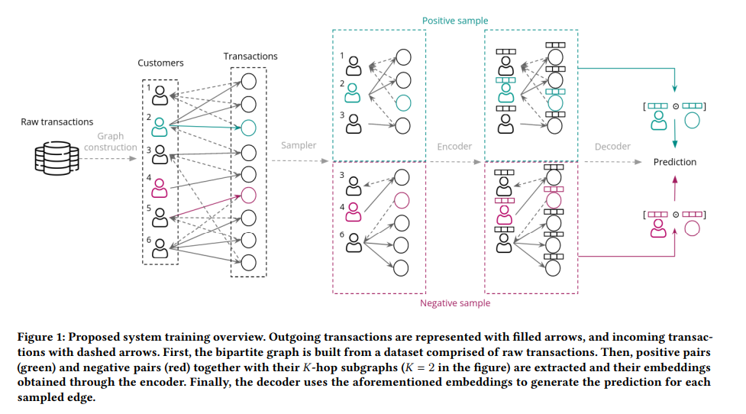
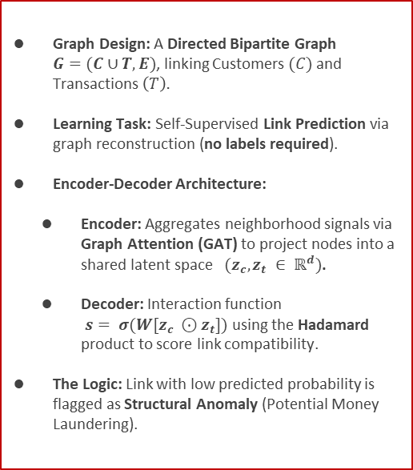
Methodology: LaundroGraph
Graph Design: A Directed Bipartite Graph $G=(C∪T, E)$, linking Customers$(C)$ and Transactions $\left(T\right).$
Learning Task: Self-Supervised Link Prediction via graph reconstruction (no labels required).
Encoder-Decoder Architecture:
Encoder: Aggregates neighborhood signals via Graph Attention (GAT) to project nodes into a shared latent space $(z_{c}, z_{t} ∈ ℝ^{d})$.
Decoder: Interaction function $s= σ(W[z_{c} ⊙z_{t}])$using the Hadamard product to score link compatibility.
The Logic: Link with low predicted probability is flagged as Structural Anomaly (Potential Money Laundering).
SPML - Self-Supervised Link Prediction vs. Supervised Classification in Graph Neural Networks for Anti-Money Laundering

Slide 4
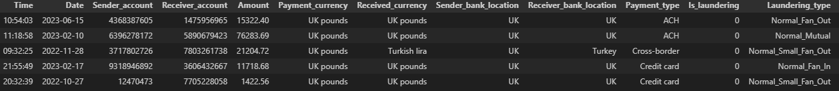
Dataset & Feature Engineering (SAML-D)
Composition: 855k Customers and 9.5M Transactions.
Typologies: 28 distinct behavioral patterns (17 suspicious / 11 normal)
Temporal Split:
Profile Window (2022/10 – 2023/02): Customer Profiling Period.
Training Window (2023/03 – 2023/07): Model learning phase.
Testing Window (2023/08): Out-of-time evaluation on unseen future transactions.
Laundering Rate (Target): 0.1%.
Customer Nodes (123 Dimensions):
Behavioral Aggregates: Historical transaction volume, frequency (velocity), In/Out fund balance, cash-volume ratios, avg. "Cash-to-Wire" speed, rapid "In-and-Out" counts.
Anomaly Indicators: Engineered counts for "Structuring" behavior
Risk Context: Density of interactions with high-risk jurisdictions or sanctioned entities.
Transaction Nodes (49 Dimensions):
Intrinsic Properties: Numerical amount (log-normalized), currency types, payment channels, bank locations.
Temporal Dynamics: Cyclic time features (Hour/Day) and "Latency" (the speed at which funds move from cash-to-wire).
SPML - Self-Supervised Link Prediction vs. Supervised Classification in Graph Neural Networks for Anti-Money Laundering

Slide 5
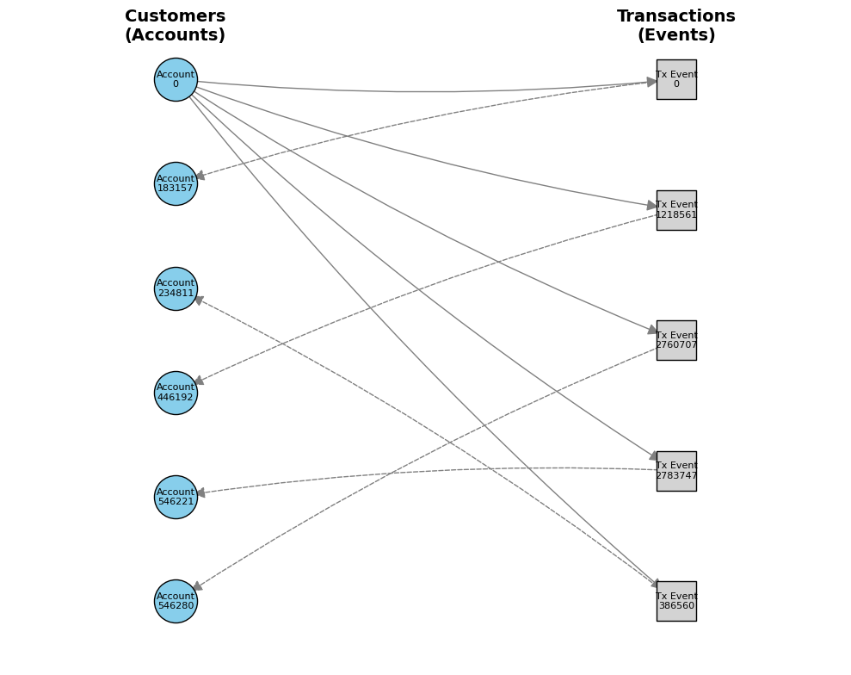
Graph Construction
Node Counts:
Total Customers: 0.7M
Total Transactions: 5.2M
Graph Ratio: 1 Customer ≈ 8 Transactions
Edge Splits:
Training Edges: 4.5M
Message Passing: 2.3M (50%)
Supervision: 1.4M (30%)
Validation: 0.9M (20%)
Test Edges: 0.7M
SPML - Self-Supervised Link Prediction vs. Supervised Classification in Graph Neural Networks for Anti-Money Laundering

Slide 6
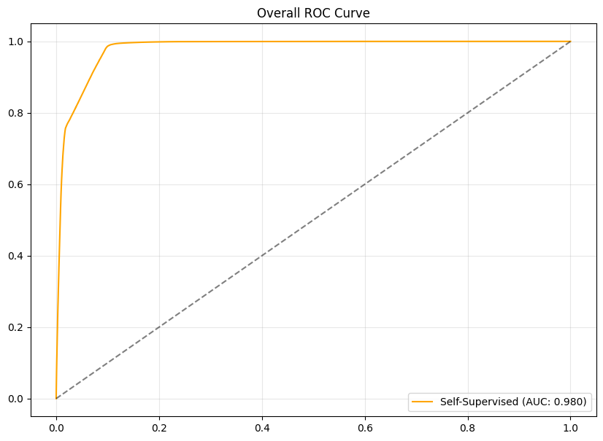
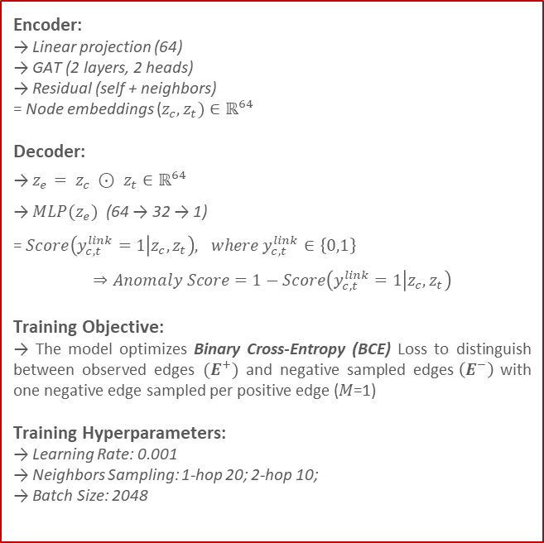
Experiment 1: LaundroGraph (Self-Supervised approach)
Encoder:
→ Linear projection (64)
→ GAT (2 layers, 2 heads)
→ Residual (self + neighbors)
= Node embeddings ($z_{c}, z_{t})∈ℝ^{64}$
Decoder:
→ $z_{e}= z_{c} ⊙ z_{t}∈ℝ^{64}$
→ $MLP(z_{e})$ (64 → 32 → 1)
= $Score\left(y_{c,t}^{link}=1 | z_{c}, z_{t}\right), where y_{c,t}^{link}∈\left\{0,1\right\}$
$$⇒Anomaly Score=1−Score\left(y_{c,t}^{link}=1 | z_{c}, z_{t}\right)$$
Training Objective:
→ The model optimizes Binary Cross-Entropy (BCE) Loss to distinguish between observed edges $(E^{+})$ and negative sampled edges$\left(E^{−}\right)$ with one negative edge sampled per positive edge (𝑀=1)
Training Hyperparameters:
→ Learning Rate: 0.001
→ Neighbors Sampling: 1-hop 20; 2-hop 10;
→ Batch Size: 2048
SPML - Self-Supervised Link Prediction vs. Supervised Classification in Graph Neural Networks for Anti-Money Laundering

Slide 7
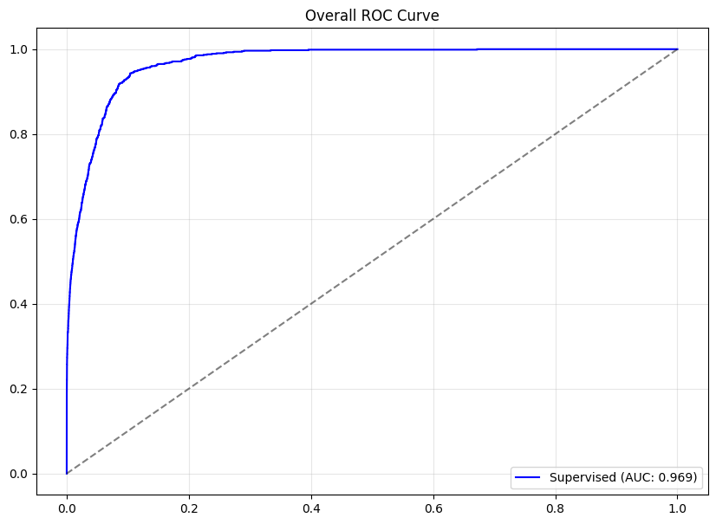
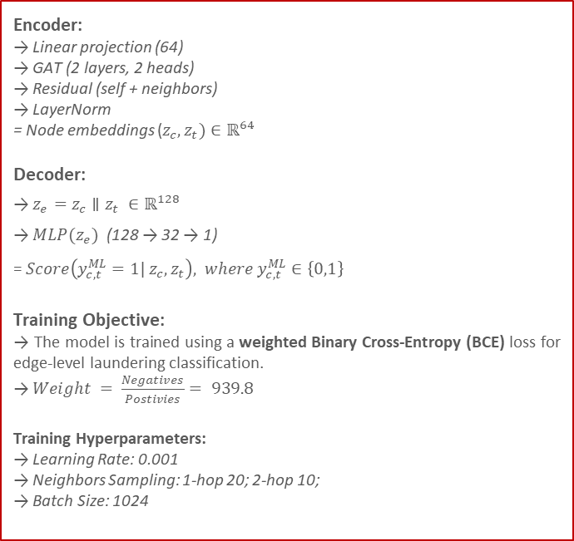
Experiment 2: Edge Classification (Supervised approach)
Encoder:
→ Linear projection (64)
→ GAT (2 layers, 2 heads)
→ Residual (self + neighbors)
→ LayerNorm
= Node embeddings ($z_{c}, z_{t})∈ℝ^{64}$
Decoder:
→ $z_{e}=z_{c}∥z_{t} ∈ℝ^{128}$
→ $MLP(z_{e})$ (128 → 32 → 1)
= $Score\left(y_{c,t}^{ML}=1| z_{c}, z_{t}\right), where y_{c,t}^{ML}∈\left\{0,1\right\}$
Training Objective:
→ The model is trained using a weighted Binary Cross-Entropy (BCE) loss for edge-level laundering classification.
→ $Weight = \frac{Negatives}{Postivies}= 939.8$
Training Hyperparameters:
→ Learning Rate: 0.001
→ Neighbors Sampling: 1-hop 20; 2-hop 10;
→ Batch Size: 1024
SPML - Self-Supervised Link Prediction vs. Supervised Classification in Graph Neural Networks for Anti-Money Laundering

Slide 8
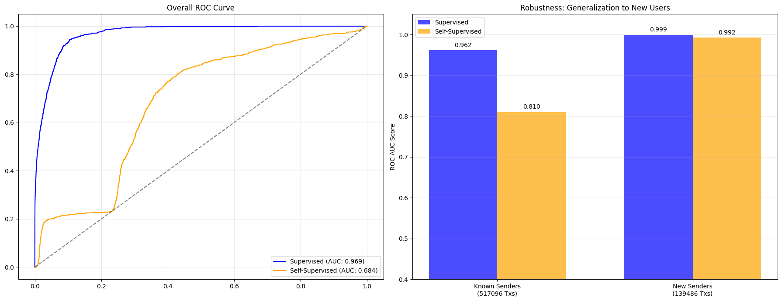
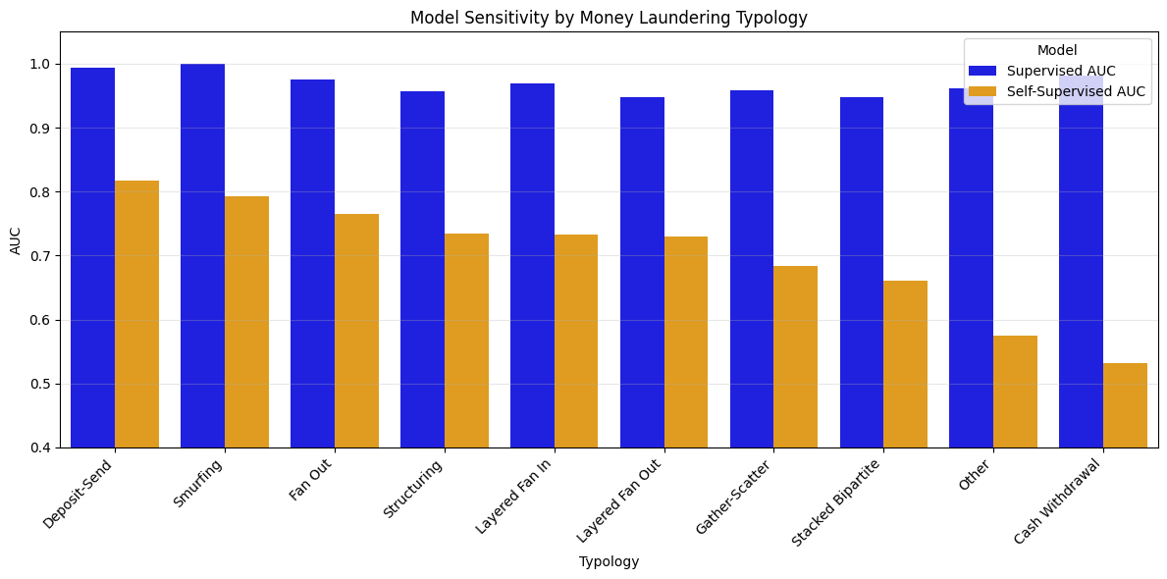
Self-Supervised VS Supervised approaches
Performance Insight: While Supervised learning dominates overall, the Self-Supervised model achieves strong detection (~80% AUC) on some crime type (like Smurfing) without using any labels.
SPML - Self-Supervised Link Prediction vs. Supervised Classification in Graph Neural Networks for Anti-Money Laundering

Slide 9
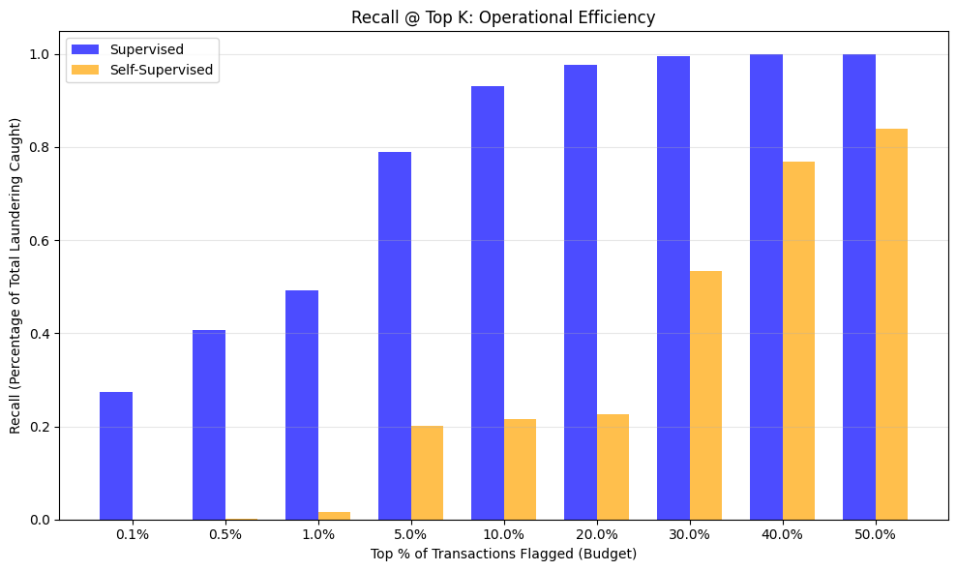
Recall @ K (Operational Effectiveness)
Supervised:
High Efficiency: Catches ~80% of money laundering by reviewing just the top 5% of transactions.
Operational Role: Ideal for primary, automated blocking of known threats.
Self-Supervised:
Lower Efficiency: Requires a larger review budget (top 30-40%) to achieve comparable recall.
Why? It flags all anomalies, not just fraud. The top 1% contains many "weird but legal" transactions (False Positives).
Operational Role: Best used as a secondary "Safety Net" to investigate accounts that pass the Supervised check but behave strangely.
SPML - Self-Supervised Link Prediction vs. Supervised Classification in Graph Neural Networks for Anti-Money Laundering

Slide 10
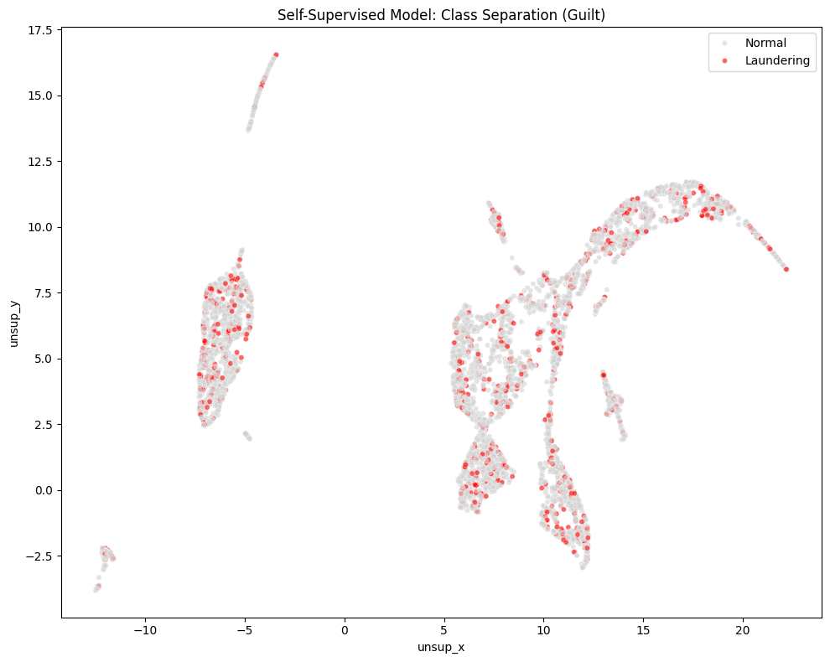
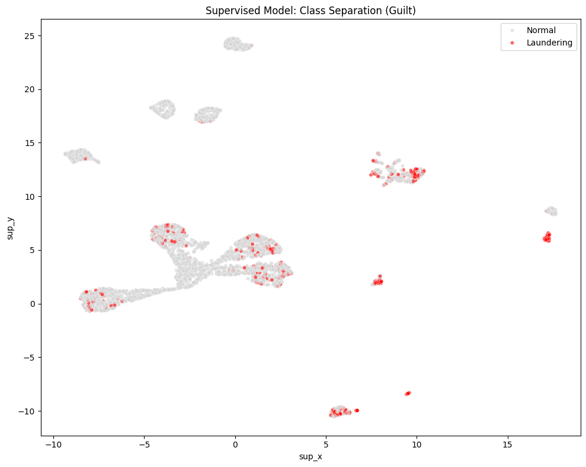
Embeddings (Transactions)
Result: Significant overlap. The Red points are mixed deep within the Grey clusters.
Reason: The model was never shown labels. It groups transactions based on structural similarity.
Result: Perfect separation. The "Laundering" (Red) points are pushed far away from "Normal" (Grey) points.
Reason: The model was explicitly trained to discriminate between these two classes. It learned "Guilt."
SPML - Self-Supervised Link Prediction vs. Supervised Classification in Graph Neural Networks for Anti-Money Laundering

Slide 11
Conclusions
Geometry Drives Detection:
Success (Smurfing, ~80% AUC): The model excels at detecting crimes with unnatural shapes. Typologies like Smurfing create "Star" patterns (high-degree hubs) that stand out mathematically as structural anomalies
Limitation (Cash Withdrawal, ~53% AUC): Crimes that lack a distinct shape fail. A withdrawal creates a Single Edge, which looks topologically identical to a legitimate purchase.
The "Structural Mimicry" Barrier:
Self-Supervised learning struggles when criminal behavior intentionally mimics complex legal flows (e.g., Stacked Bipartite resembling payroll). Without labels, the model cannot separate these "good" and "bad" twins.
A Hybrid Strategy:
Supervised Models: Deploy as the "Front Line" to block known, simple threats efficiently
Self-Supervised Models: Deploy as a "Discovery Tool" to uncover rare, complex anomalies that supervised rules have never seen before.
SPML - Self-Supervised Link Prediction vs. Supervised Classification in Graph Neural Networks for Anti-Money Laundering

Slide 12
References
Mário Cardoso et al. (2022) “LaundroGraph: Self-Supervised Graph Representation Learning for Anti-Money Laundering”
Berkan Oztas et al. (2023) “Enhancing Anti-Money Laundering: Development of a Synthetic Transaction Monitoring Dataset”
Dawei Cheng et al. (2024) “Graph Neural Networks for Financial Fraud Detection: A Review“

Slide 13
Thank you for the attention!
Feb 2026

Slide 14
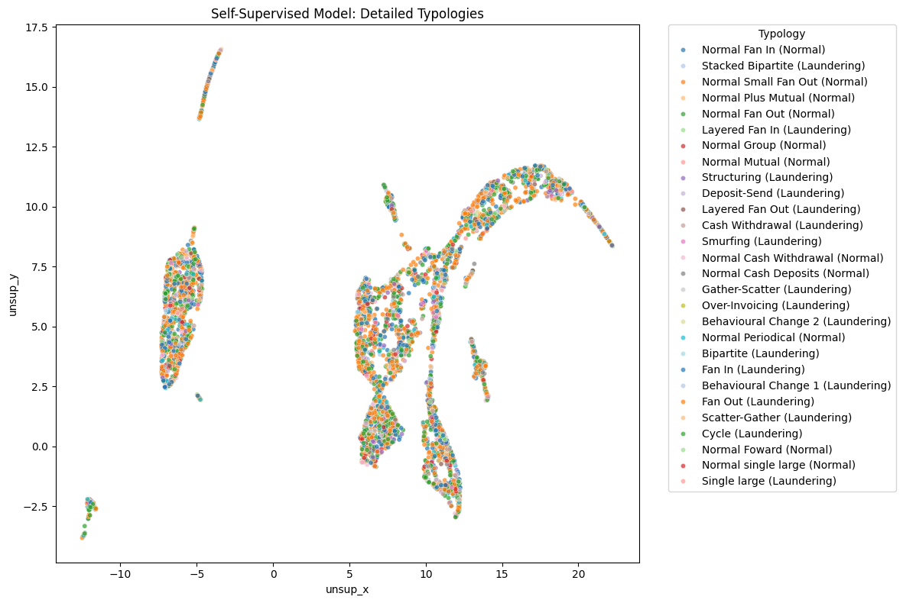
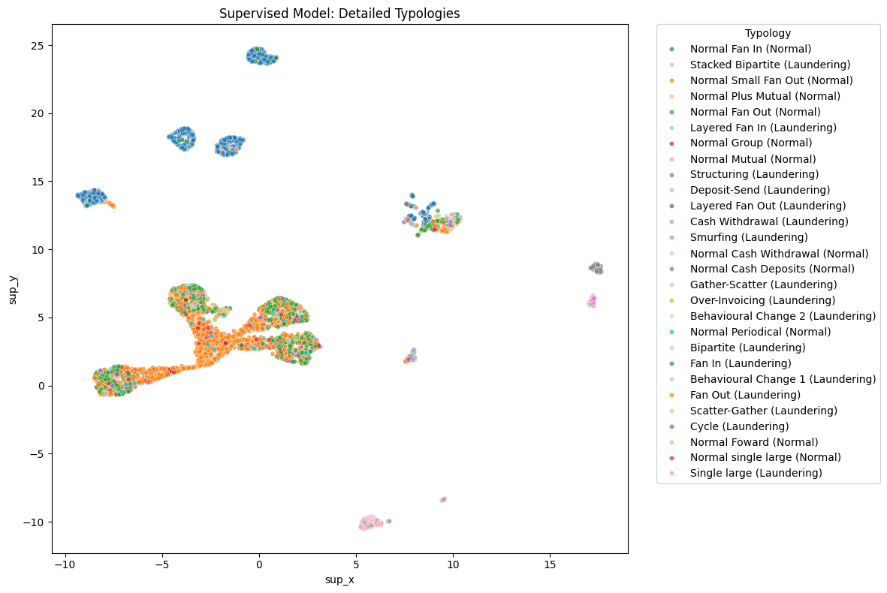
Extra Slides (Embeddings)
SPML - Self-Supervised Link Prediction vs. Supervised Classification in Graph Neural Networks for Anti-Money Laundering

Slide 15
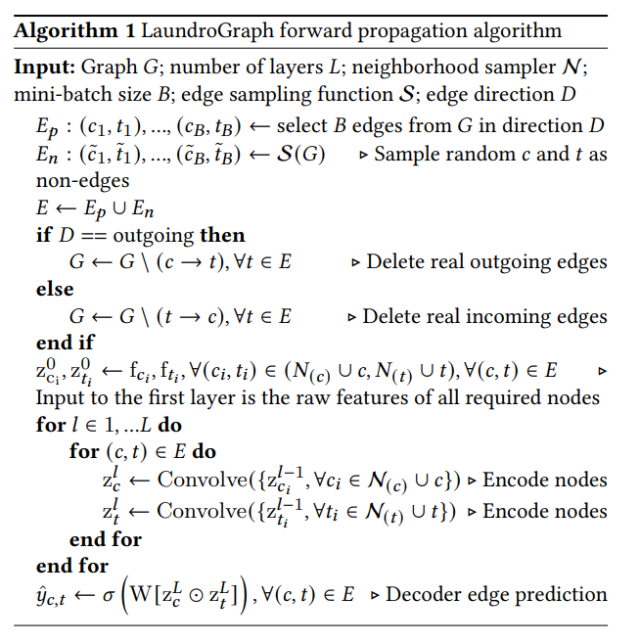
Extra Slide (LaundroGraph Algorithm)
SPML - Self-Supervised Link Prediction vs. Supervised Classification in Graph Neural Networks for Anti-Money Laundering

